Slide 1
“Voice-based Parkinson’s Disease Detection Using XG-Boost Algorithm”
1

Slide 2
Group Members
Amit Baral
Narayan Pokhrel
Roll No.: 19070261
Roll No.: 19070271
2
Pratima Bhandari
Sailesh Gurung
Roll No.: 19070274
Roll No.: 19070279

Slide 3
Table of contents
01
02
03
04
05
Introduction
Literature Review
Methodology
3
Epilouge
References

Slide 4
Introduction
01
4

Slide 5
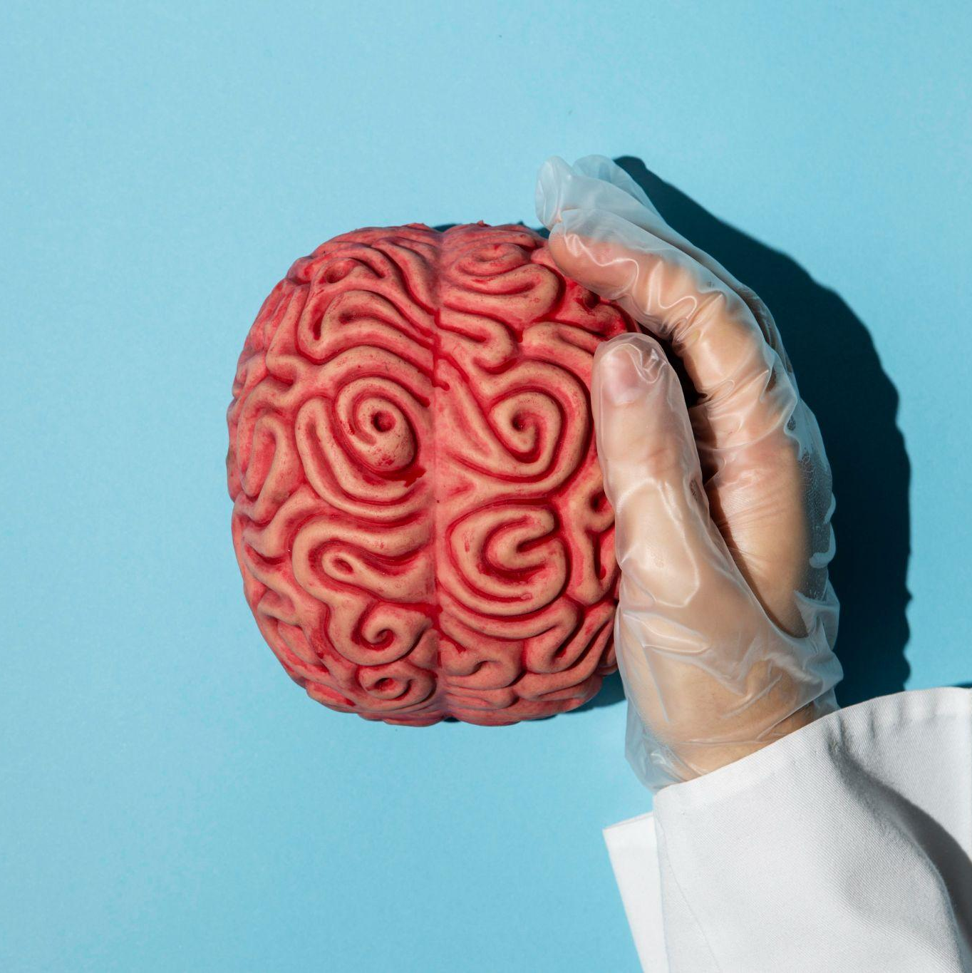
Background
Parkinson's disease is a degenerative brain condition affecting older individuals, with symptoms like slowed movements, balanced condition and reduced facial expression.
Machine learning offers for early diagnosis and improved treatment.
5

Slide 6
Problem of Statement?
Parkinson's diagnosis is complex due to variable symptoms and the lack of definitive tests.
Diagnosis relies on medical history, physical exams, and clinical assessments.
Additional tests like brain imaging and blood tests may be used to support diagnosis.
Machine learning aids diagnosis but lacks complete accuracy.
Ongoing research aims to improve diagnostic tools and algorithms for early detection.
6

Slide 7
Research Question?
Which machine learning algorithm provides more accurate prediction for Parkinson disease?
What is the effectiveness of voice-based analysis in detecting Parkinson's disease?
7

Slide 8
Objectives
To develop a real-time detection system that can analyze voice recordings instantly and provide immediate feedback on the likelihood of Parkinson's disease presence or progression.
To contrast the performance of different machine learning algorithms for Parkinson diseases detection.
8

Slide 9
Applications and Project Scope
Voice-based Parkinson's disease detection serves as a diagnostic tool for healthcare professionals.
Accessible and user-friendly, it aids in early symptom recognition and timely medical intervention.
9
It enables self-assessments at home using smartphones.

Slide 10
Limitations and Challenges
Dataset Limitations.
External Factors and Variability.
Interpretability of XGBoost Algorithm.
10

Slide 11
Literature Review
02
11

Slide 12
01
02
03
Diagnosis of Parkinson's Disease in Human Using Voice Signals
Parkinson's Disease Diagnosis Using Machine Learning and voice
12
Automatic Recognition of Parkinson Diseases via Artificial Neural Network and Support Vector Machine

Slide 13
Methodology
03
13

Slide 14
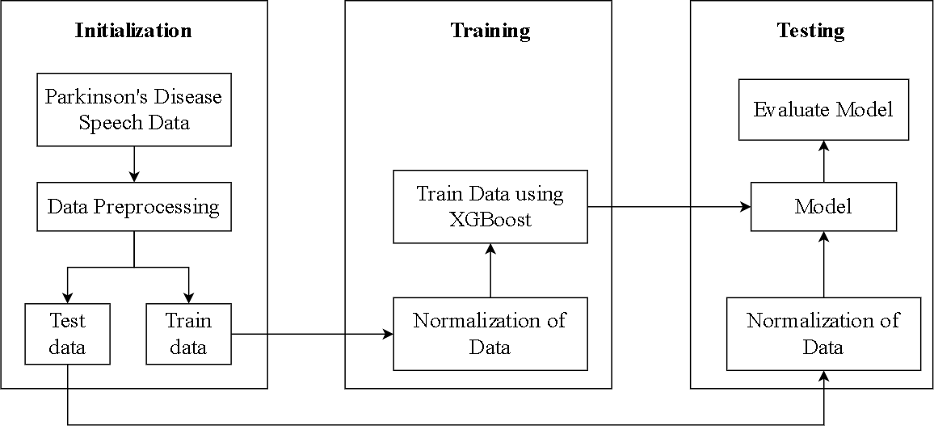
System Diagram
14

Slide 15
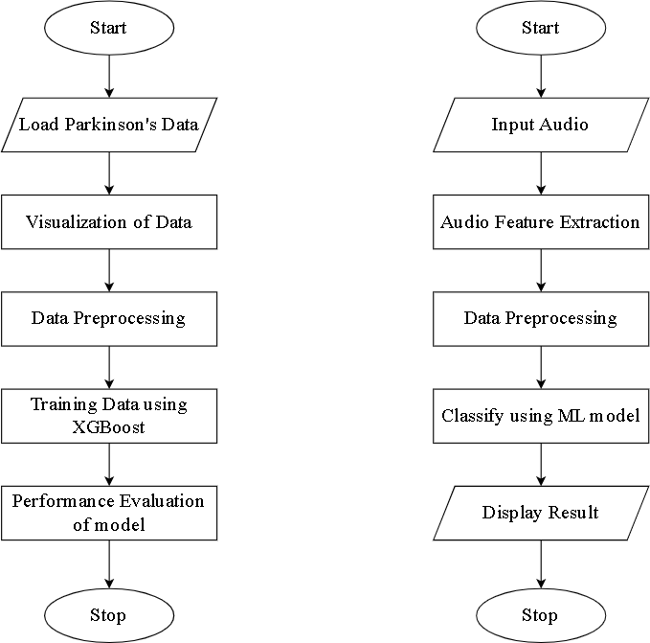
System Flowchart
15

Slide 16
Proposed Algorithms
XG-Boost Algorithm
XGBoost will be utilized in Parkinson's disease detection which effectively analyze voice data and classify individuals with Parkinson's disease based on distinctive voice features.
K-Nearest Neighbors
K-Nearest Neighbor will serve as a reference for accuracy comparison with XGBoost in Parkinson's disease detection.
16

Slide 17
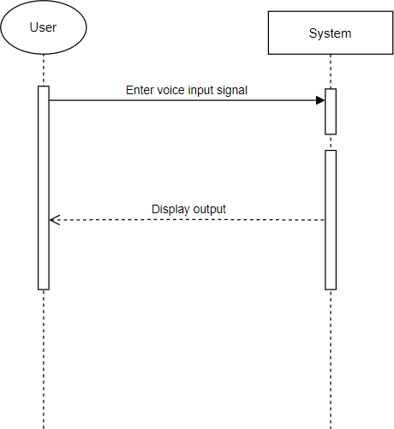
Sequence Diagram
17

Slide 18
Programming Technologies
01
02
03
04
05
Python
Jupyter Notebook
Scikit-Learn
18
06
07
Pandas
Praat and Parselmouth
Numpy
HTML/CSS

Slide 19
Epilouge
04
19

Slide 20
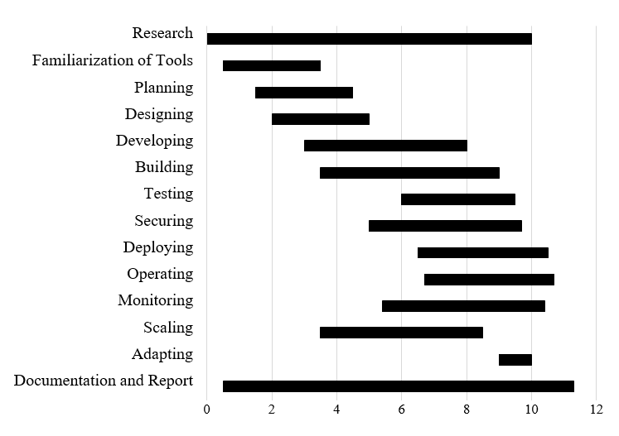
Work Schedule
20

Slide 21
Budget Analysis
Name of Resources | Amount in RS
Web Hosting and Domain | NRs 25,000
Voice Recording Equipment | NRs 40,000
Testing and QA | NRs 20,000
Documentation | NRs 3,000
Transportation | NRs 5500
TOTAL | NRs 93,500
21

Slide 22
References
[1] S. Bind, A. K. Tiwari and A. Kumar, "A Survey Of Machine Learning Based Approaches For Parkinson Disease Prediction," ResearchGate, vol. 10, no. 7, p. 5, July 2022.
[2] N. B H, N. S C, P. U. K. KP and N. , "Prediction Of Parkinson's Disease Using XGBoost Classifier Machine Learning," IEEE, vol. 10, no. 7, p. 5, July 2022.
[3] E. F. S, E. S. T C and V. D. R S, "Prediction of Parkinson's disease using XGBoost," 2022 8th International Conference on Advanced Computing and Communication Systems (ICACCS), Coimbatore, India, 2022, pp. 1769-1772, doi: 10.1109/ICACCS54159.2022.9785227.
[4] H. K. Rouzbahani and M. Daliri, "Diagnosis of Parkinson's Disease in Human Using Voice Signals," ResearchGate, p. 10, February.
22

Slide 23
References
[5] T. J. Wroge, Y. Ozkanca, C. Demiroglu, D. Si, D. C. Atkins and R. h. Ghomi, "Parkinson's Disease Diagnosis Using Machine Learning and voice," IEEE, p. 7, 2018.
[6] A. Sharma and R. N. Giri, "Automatic Recognition of Parkinson Diseases via Artificial Neural Network and Support Vector Machine," International Journal of Innovative Technology and Exploring Engineering, vol. 4, no. 3, p. 8, August 2014.
[7] A. Caliskan, H. Badem, A. Basturk and M. Yuksel, "Diagnosis Of The Parkinson Disease by using Deep Neural Network Classifier," Journal Of Electrical and Electronics Engineering, vol. 17(2), p. 10, 27 July 2017.
[8] "What is the Software Development Life Cycle? SDLC Explained," Courses, [Online]. Available: https://www.coursera.org/articles/software-development-life-cycle. [Accessed 22 May 2023].
23

Slide 24
References
[9] "Block diagram of the proposed Parkinson's disease detection system," [Online]. Available: https://www.researchgate.net/figure/Block-diagram-of-the-proposedParkinsons-disease-detection-system_fig1_321970267. [Accessed 22 may 2023].
[10]"XGBoost,"GeeksforGeeks, 06 February 2023. [Online]. Available: https://www.geeksforgeeks.org/xgboost/. [Accessed 22 May 2023].
[11]"K-Nearest Neighbor(KNN) Algorithm," GeeksforGeeks, [Online]. Available: https://www.geeksforgeeks.org/k-nearest-neighbours/. [Accessed 5 may 2023].
[12]"Python Tutorial," w3schools, [Online].Available: https://www.w3schools.com/python/default.as. [Accessed 22 may 2023].
24

Slide 25
Thank you!
Do you have any questions?
25

